Slide 1
= Believers in Christ

Slide 6
~As Salt of the earth we can season what is tasteless.
~As Salt of the earth we are called to preserve what is deteriorating.
~As Salt of the earth we are called to be the antiseptic this world needs.
Jesus said we are the Salt of the earth.

Slide 11
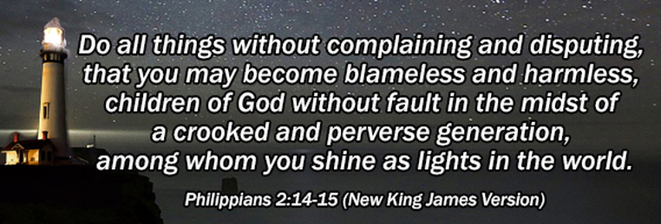

Slide 13
Isaish 60;1-3 NASB 1-"Arise, shine; for your light has come, And the glory of the LORD has risen upon you. 2-"For behold, darkness will cover the earth And deep darkness the peoples; But the LORD will rise upon you And His glory will appear upon you. 3-"Nations will come to your light, And kings to the brightness of your rising.…

Slide 14
1-Arise [from the depression and prostration in which circumstances have kept you—rise to a new life]! Shine (be radiant with the glory of the Lord), for your light has come, and the glory of the Lord has risen upon you! Isaiah 60;1

Slide 20
John Stott—a pastor to pastors, a servant of the global church, and author of more than 50 books. He was awarded a Lambeth doctorate in divinity (DD) in 1983 and has honorary doctorates from universities in America, Britain, and Canada.
Christians are marked people. The world is watching. God’s major way of transforming the old society is to implant within it his new society, with its different values, different standards, different joys, and different goals. Our hope is that the watching world will see these differences and find them attractive, that they may see our good deeds and glorify our father in heaven.
There is formidable power in a dedicated minority. Stott quotes American sociologist Robert Belair:
We should not underestimate the significance of the small group of people who have a vision of a just and gentle world. The quality of a whole culture may be changed when two percent of its people have a new vision.
Is this not what Jesus did? He took a small group of only twelve dedicated disciples and within a few years their influence was felt across the entire Roman world.

